Slide 1
Scientific calculator using of GUI Tkinter library of python
Present by : Rahul Makwana

Slide 2
Introduction
A scientific calculator is a calculator designed to calculate mathematics problems.
Capabilities of scientific calculator include :
Logarithmic fuctions, using base 10
Trigonometric fuctions
Square root, cube root
Some mathematics operations as addition , multiplication , divided by etc..

Slide 3
About the project
A scientific calculator is hand-held device useful for performing mathematical calculations and used in everyday lives. Which is made by using of tkinter library in python.
While creating any GUI applications there are mainly two steps :
Create a user interface
Add functionalities to the GUI by using of python

Slide 4
How to create gui using tkinter ?
Import the Tkinter module
Create the GUI application main window
Add widgets
Enter the main loop

Slide 5
Tools and creating a first window
Tools - Python
Python library - Tkinter
Tkinter - python combined with tkinter provides a fast and easy way to create GUI applications
Creating a first window :-
From tkinter import *
Root = TK()
Root.mainloop()

Slide 6
Tkinter programming
Import tkinter module from python.
Create a GUI application main window with dimension.
Create label , entry box etc.
Create of buttons of required operations ( + ,- ,* , / , 0 to 9 )
Create of trigonometry function (sin ,cos ,tan ,log ,cube root , square root)
Create function of requirements of mathematics operations.

Slide 7
Operator and description
Buttons – Display buttons in your application ( same calculations of sum , minus etc..)
Entry - Display a single line text field for accepting value from a user.
Label - Used provide a single line caption for other widgets.
Mathematics operation description :-
square root - find square root of numbers
Xy - x raised to the power y
Trig function – find the degree angle of sin ,cos ,tan etc..
log - calculation of form log 10 x
Pi - pi is displayed as 3.141592654

Slide 8
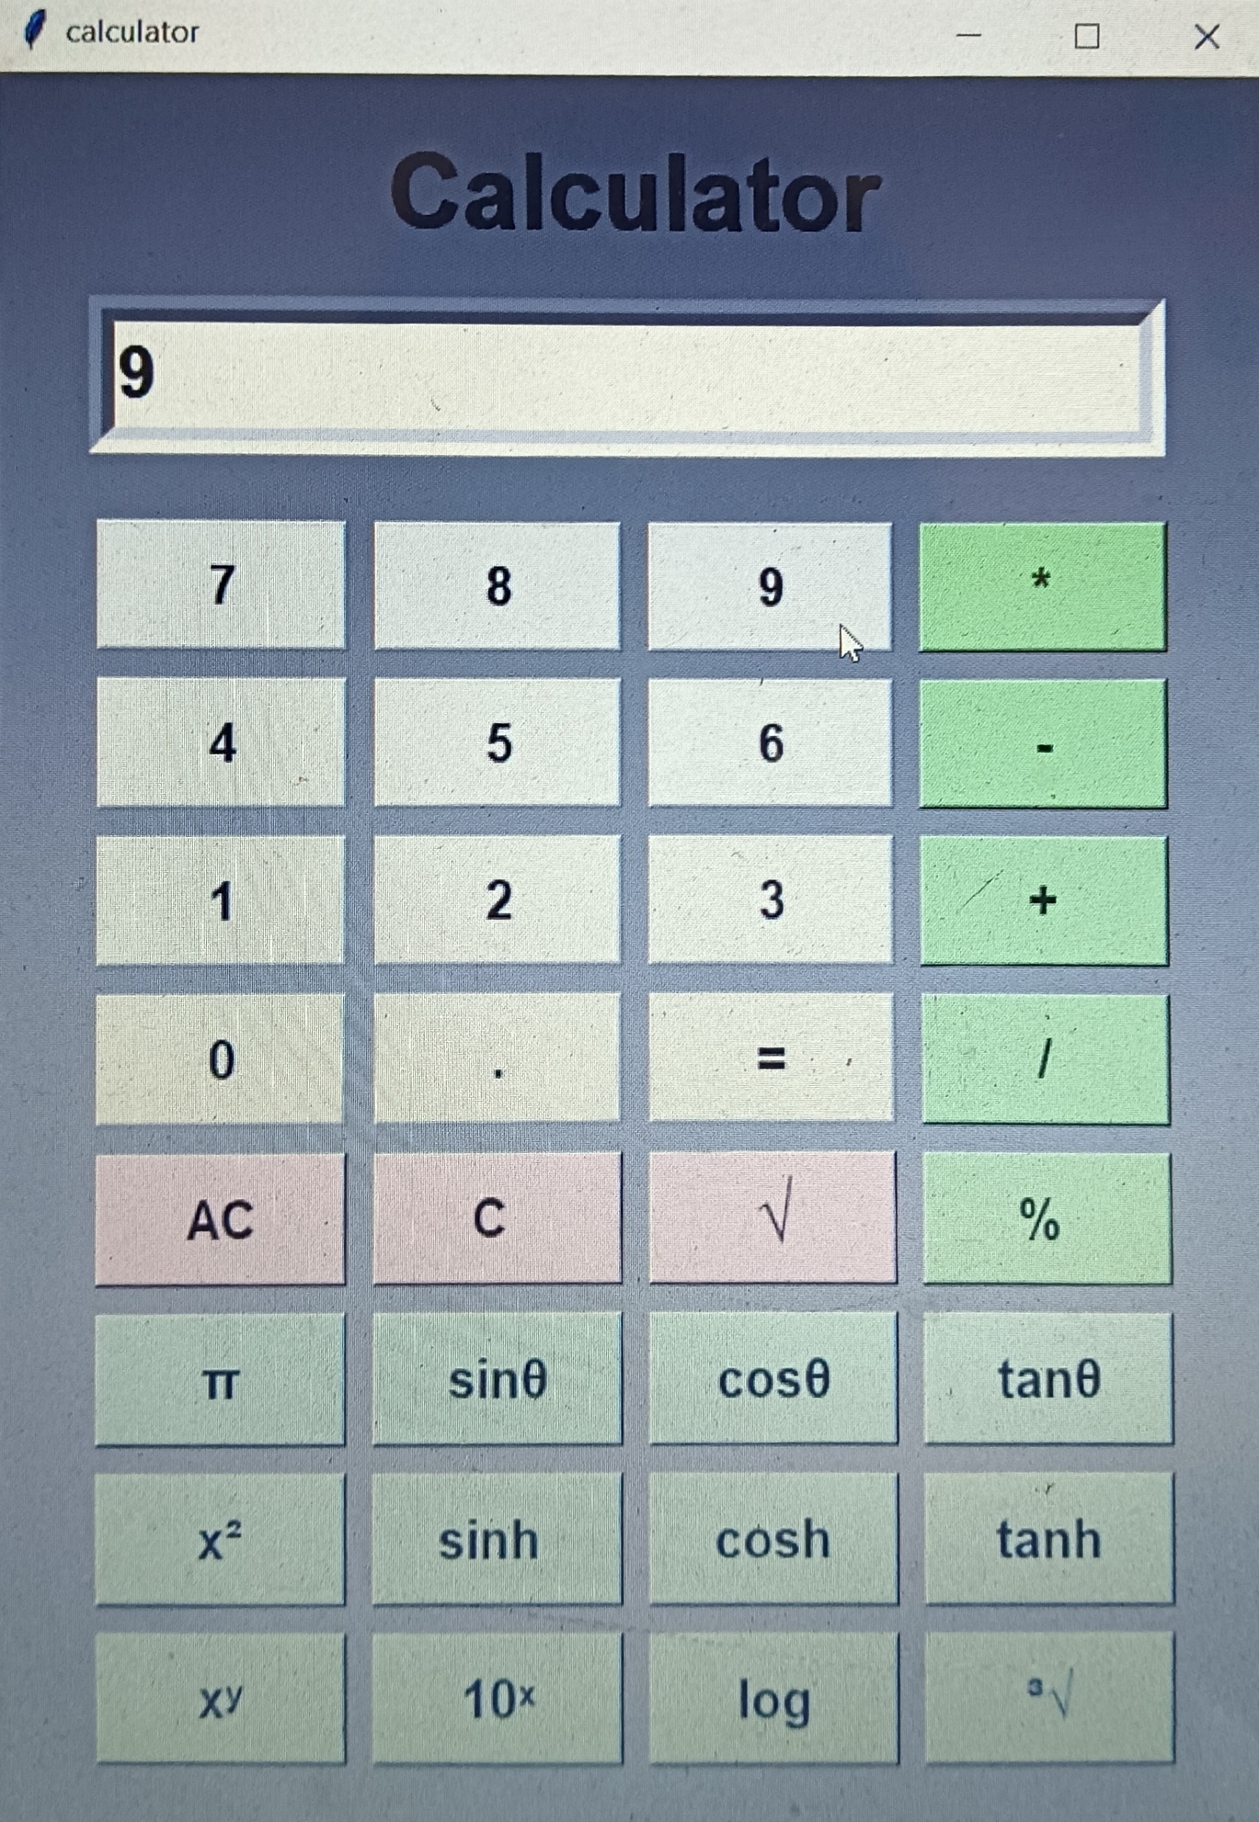
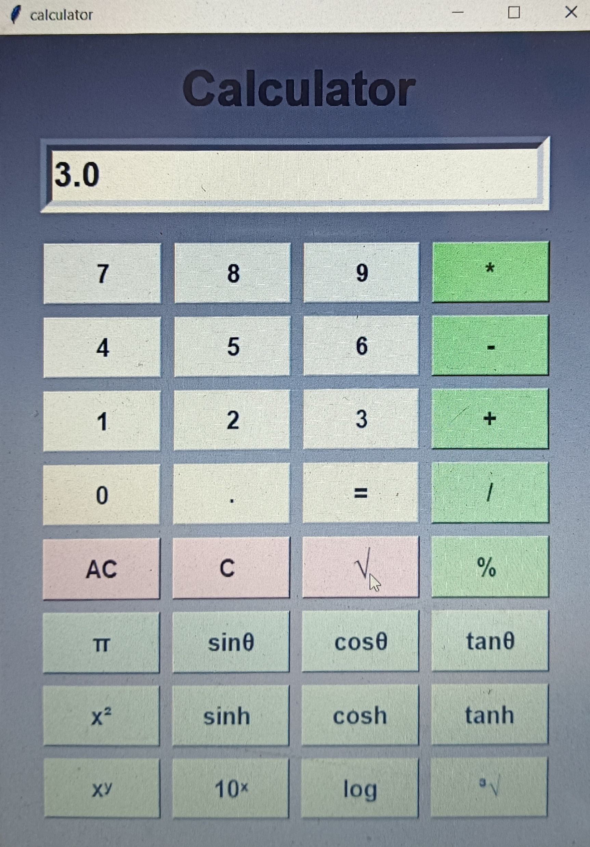
Output of programming code
Find square root of 9
Output

Slide 9
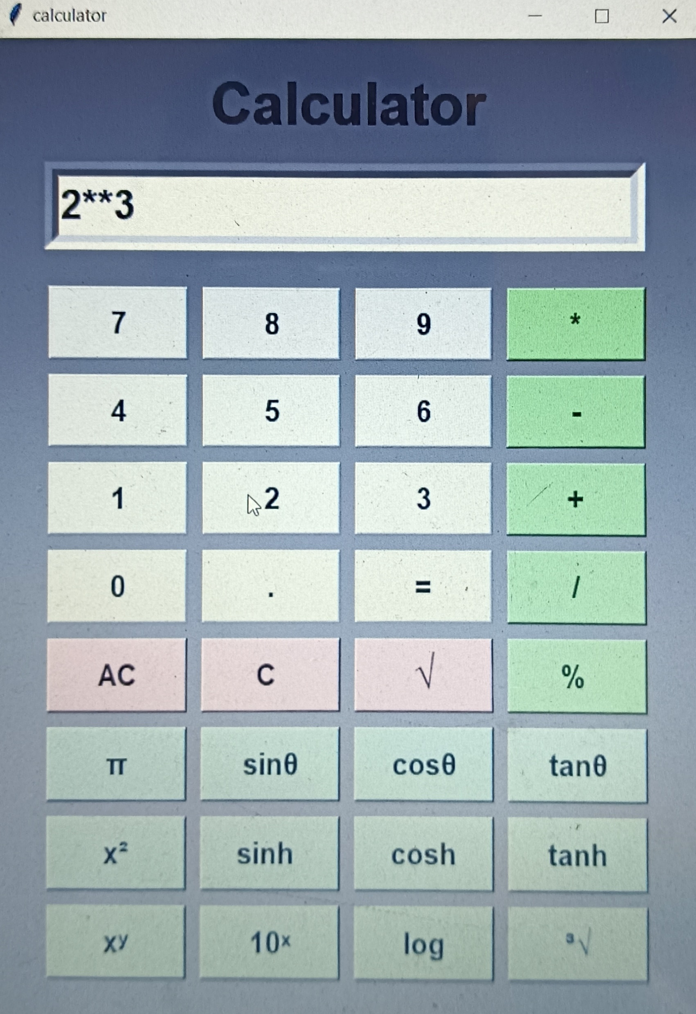
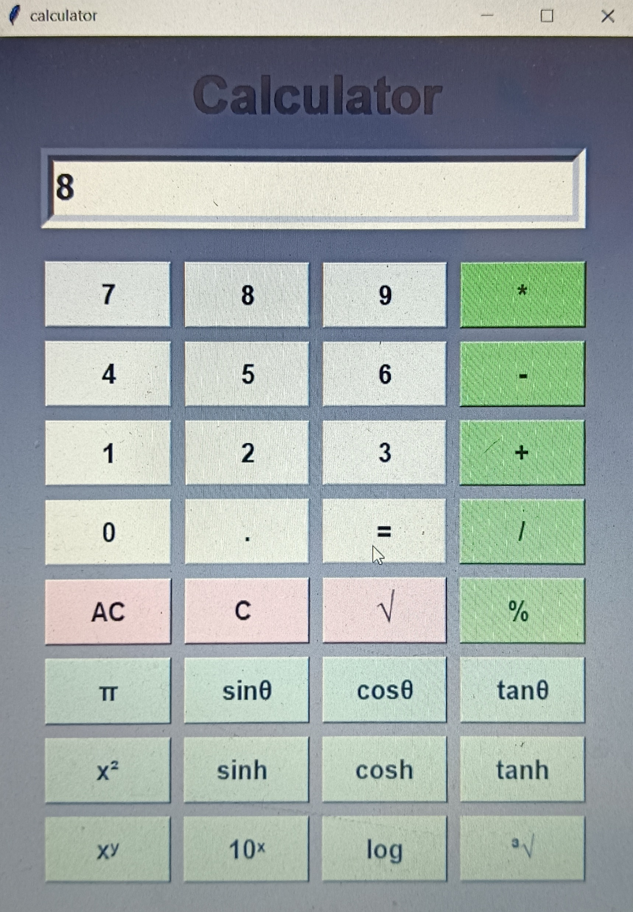
Mathematics operation example
X raised to the power of y
Output

Slide 10
Conclusion
The proposed system is error free. The concept of python language are implemented into the system. As, the usage of python tkinter as the GUI provided various controls, such as buttons ,labels , and text boxes to build a user friendly application.
Scientific calculator use in daily life and solve the problem by using it.
I am learn about this project how to use of tkinter library of python in GUI applications and how to work it and applied function.

